Slide 1
Analisa Simpul & Mesh
(Nodal & Mesh Analysis)
Department of Electrical Engineering,
University of Indonesia

Slide 2
Kirchhoff’s Current Law: i₁ = i₂ + i₃
This equation can also be written in the following form:
i₁ – i₂ – i₃ = 0
i₁
node
i₂
i₃
A formal statement of Kirchhoff’s Current Law:
The sum of all the currents entering a node is zero.
(i₂ and i₃ leave the node, hence currents –i₂ and –i₃ enter the node.)

Slide 3
Example 1: Kirchhoff’s Current Law:
Q: How much is the current I_{o} ?
A: i_{o} = 2.5 mA + 4 mA = 6.5 mA
2.5 mA
4 mA
i_{o}
i₄
i₂
i₃
The dotted circle is a node with 2.5 mA entering
Hence i₂ = 2.5 mA exits the “node”.
Similarly, i₃ = 4 mA.
From KCL, i₄ = i₂ + i₃ = 6.5 mA, and I_{o} = i₄

Slide 4
Nodal Analysis
Step 1: Determine the earth node (whose voltage is zero).
Step 2: Determine & number the other nodes. Give @ node a voltage value e.g. v1, v2,..
Step 3: Where there are voltage sources; determine some node voltages by inspection.
Step 4: Use KCL to write down equations for the remaining nodes & solve them simultaneously.
Step 5: Complete the solutions required.

Slide 5
Nodal Analysis
Use Nodal Analysis to find current through R
1
2
R
4
15

Slide 6
Nodal Analysis
Steps 1 & 2
v
1
2
R
4
15
0

Slide 7
Nodal Analysis
Step 3: is not applicable here.
Steps 4&5: solve for v &

Slide 8
Nodal Analysis
Nodal analysis to obtain i,
1
i
4
2
R
+
15
10
-

Slide 9
Nodal Analysis
Steps 1,2 & 3: identify all node voltages.
v1
v
1
i
4
2
R
+
15
10
-
By inspection; v1=15
0

Slide 10
Nodal Analysis
Determine v & solve completely

Slide 11
Nodal Analysis: 4 nodes
Use Nodal Analysis; find
2
6
+
1
R
3
97
4
-

Slide 12
Nodal Analysis: 4 nodes
Steps 1,2 & 3: identify all node voltages.
1
2
3
2
6
+
1
R
3
97
4
-
0

Slide 13
Nodal Analysis: 4 nodes
Determine v3 & solve completely

Slide 14
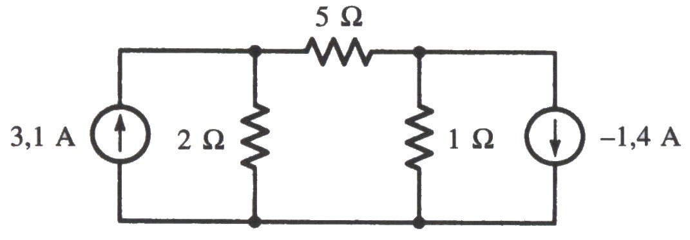
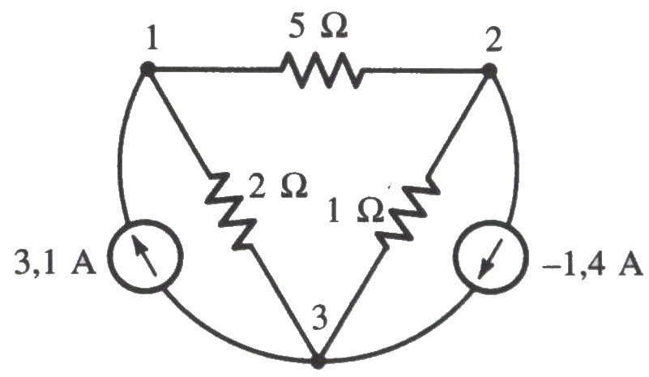
Cont’d
Gambar ulang rangkaian, untuk memperjelas simpul

Slide 15
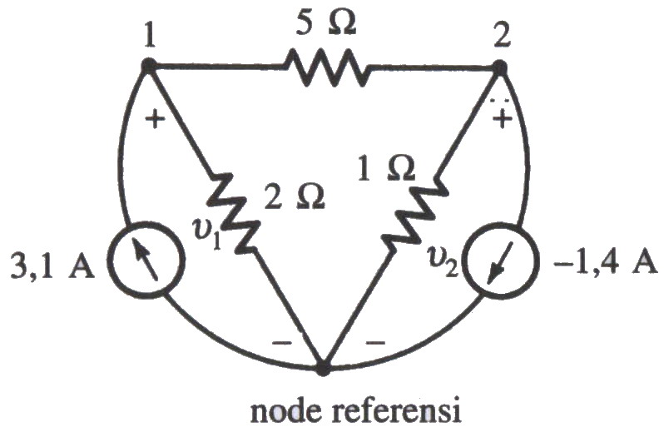
Cont’d
Beri label tegangan & tentukan node referensi

Slide 16
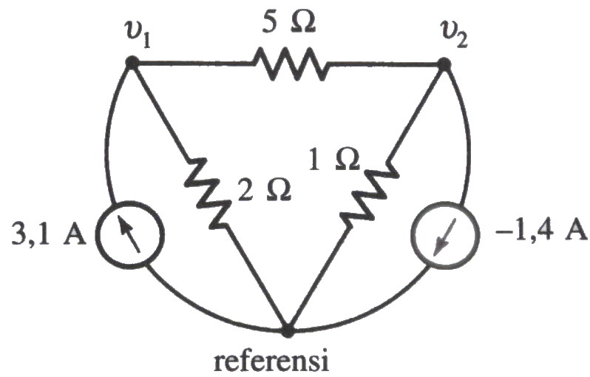
Cont’d
V₁ = tegangan simpul 1 relatif terhadap simpul referensi
V₂ = tegangan simpul 2 relatif terhadap simpul referensi

Slide 18
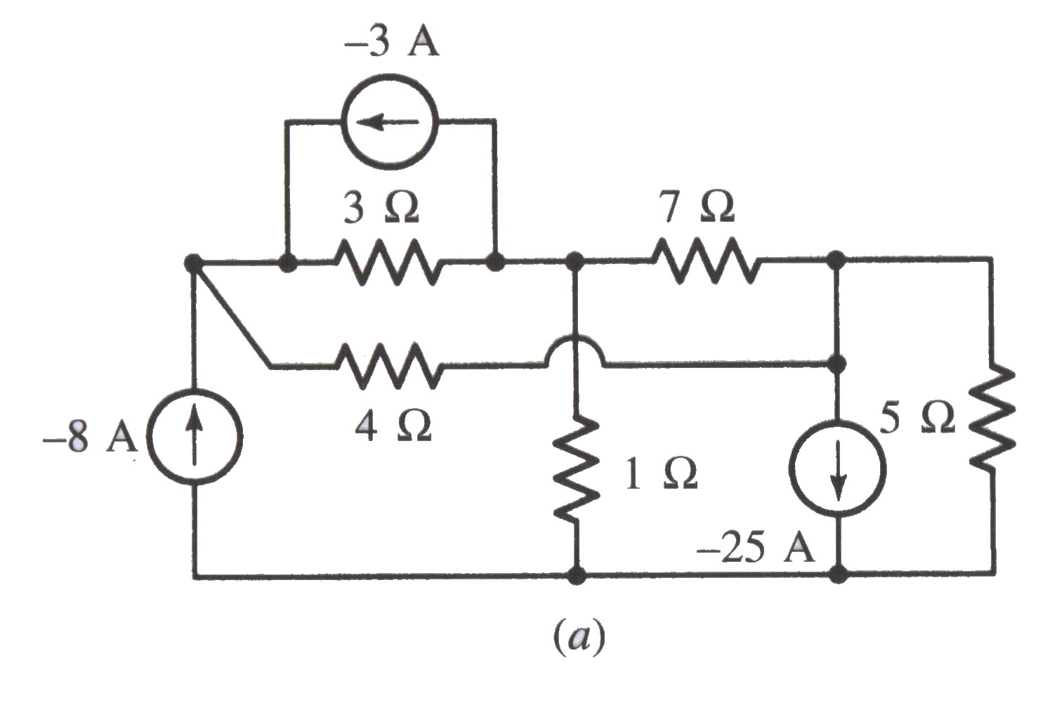
Latihan
Carilah tegangan-tegangan simpul pada gambar di bawah ini !

Slide 19
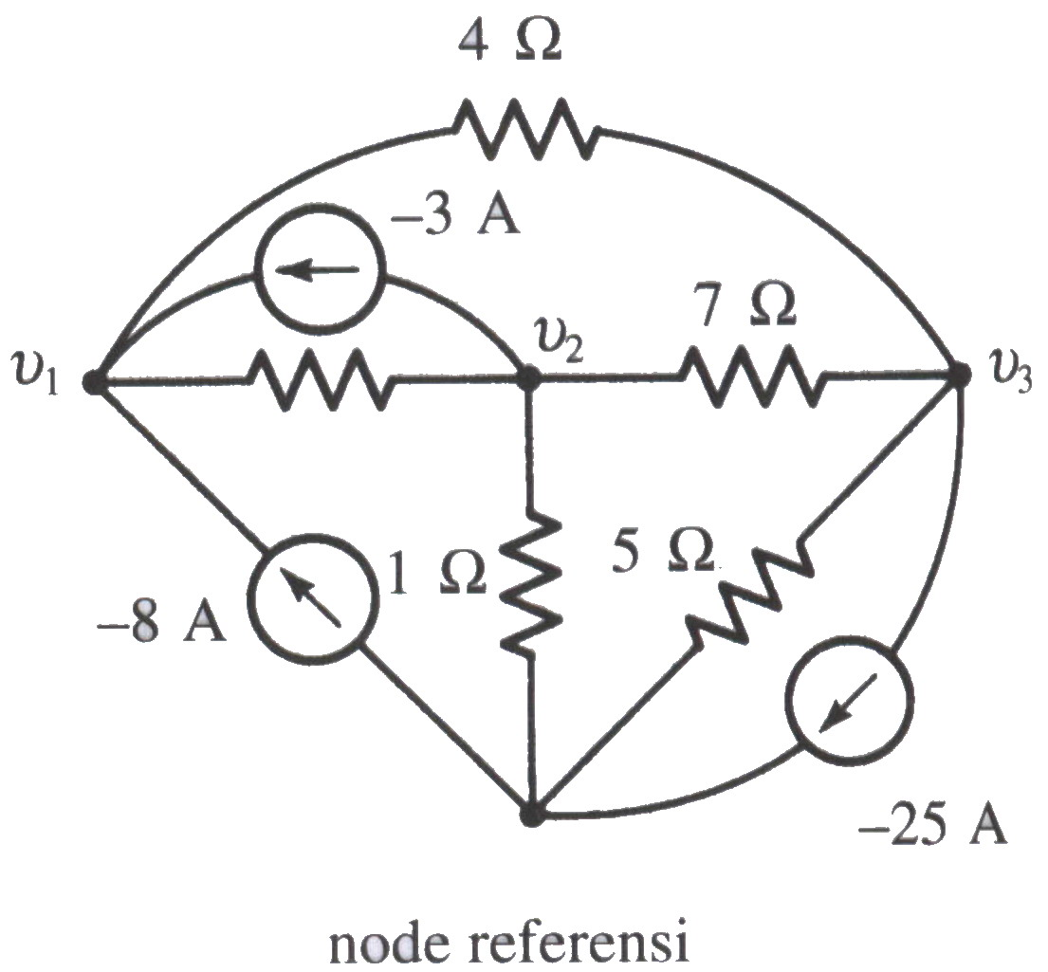
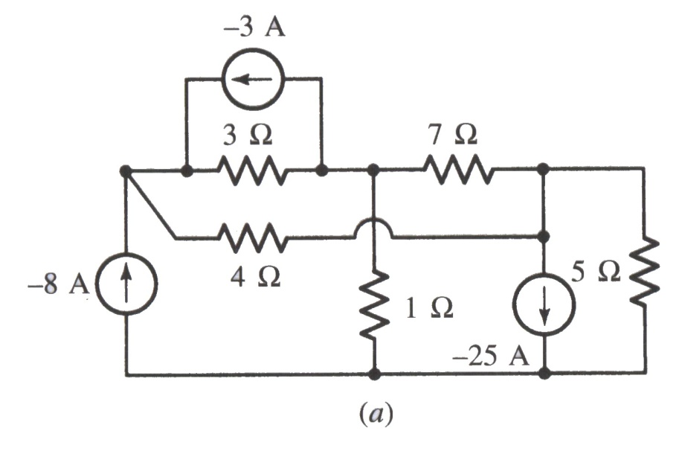

Slide 20
Cont’d
Simpul 1
Simpul 2

Slide 21
Cont’d
Simpul 3

Slide 22
Cont’d

Slide 23
Cont’d

Slide 24
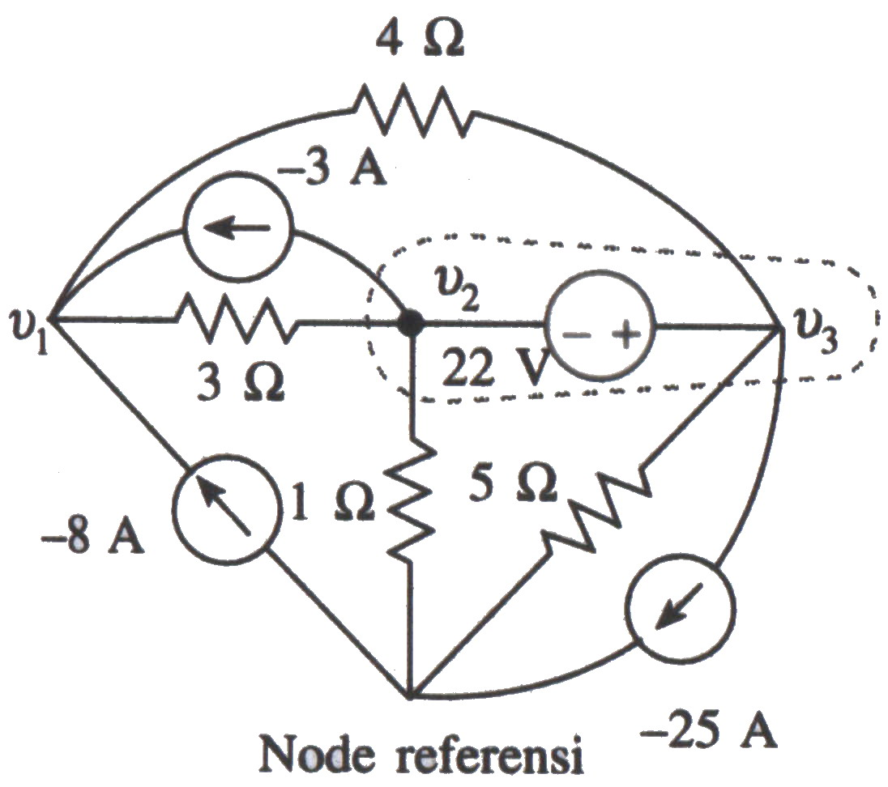
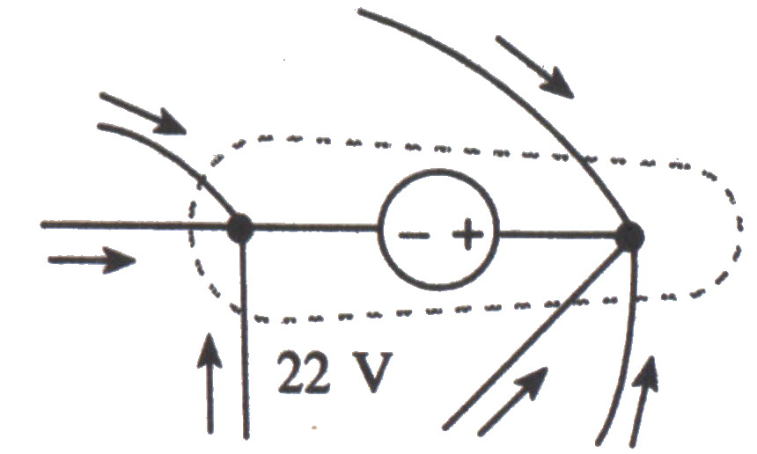
Simpul Super
Terdapat sumber tegangan di antara dua buah simpul

Slide 25
Contoh
Tentukan tegangan pada simpul 1, V₁, dari gambar (slide sebelumnya)
Simpul 1
Simpul super

Slide 26
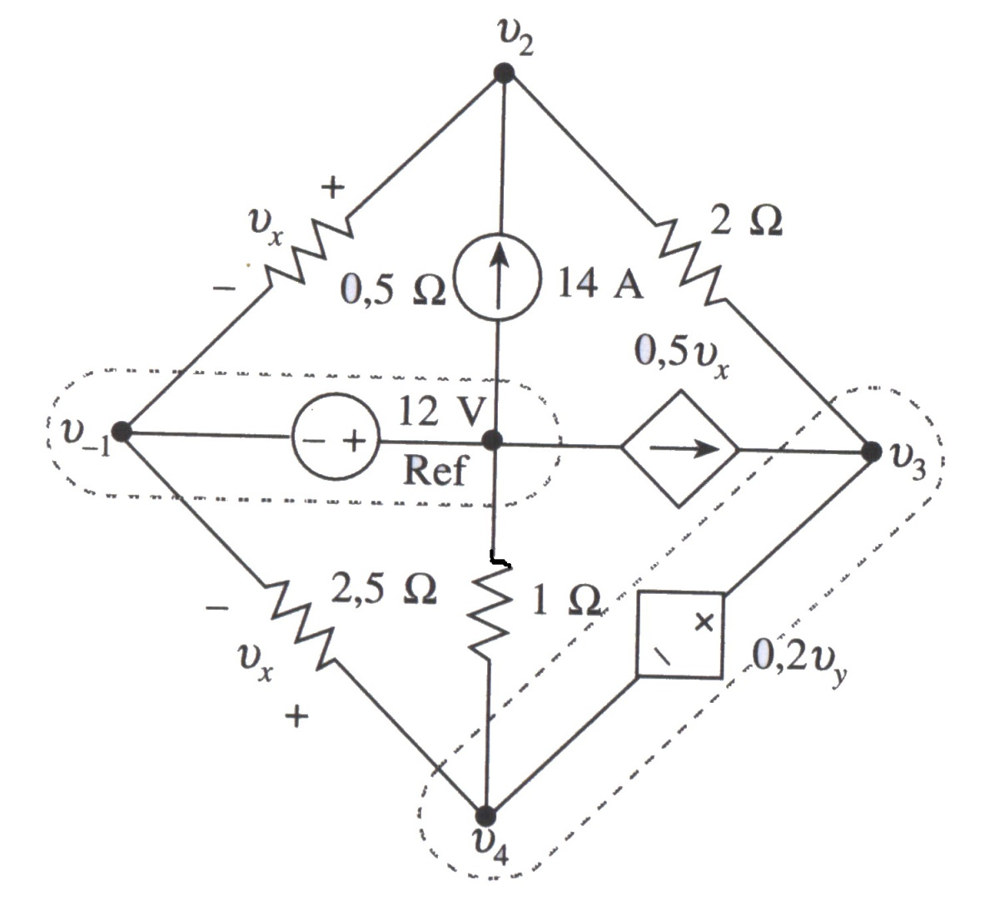
Latihan
Tentukan tegangan-tegangan simpul terhadap referensi !

Slide 27
Cont’d
Pada simpul 2
Pada simpul super 3 – 4
Simpul super

Slide 28
Cont’d
Persamaan sumber tak bebas lainnya
Eliminasi Vx dan Vy

Slide 29
Analisis Mesh
Kirchhoff’s Voltage Law: v1 = v2 + v3
dapat juga ditulis :
–v1 + v2 + v3 = 0
+ v2 –
+
v1
–
+
v3
–
+
v4
–
+
_
Kirchhoff’s Voltage Law:
Jumlah seluruh tegangan pada loop tertutup sama dengan nol.

Slide 30
Cont’d
+ 3.1V –
+
6.8 V
–
+
v4
_
+
_
Vo
Q: Berapa tegangan v4 dan Vo?
A: v4 = 6.8 V Vo = 3.1 V + 6.8 V

Slide 31
Mesh Analysis
Step 1: Determine & give current values to @ mesh.
Step 2: Where there are current sources; determine some mesh currents by inspection.
Step 3: Use KVL to write the other mesh equations & solve them simultaneously.

Slide 32
Mesh Analysis (cont.)
Step 4: Determine the resultant current through @ resistor.
Step 5: Complete the solutions as required.

Slide 33
Ex.1: Mesh Analysis
Use Mesh Analysis to find current through R (4-ohm resistor)
1
2
4
R
15

Slide 34
Ex.1: Mesh Analysis
4
4
1
4
15
2
mesh
mesh
mesh
1
2
3

Slide 35
Ex.1: Mesh Analysis
Steps 1,2,3,4

Slide 36
Ex.2:Mesh Analysis
Use Mesh Analysis to find i &
2
i
1
4
+
R
15
10
-

Slide 37
Ex.2 Mesh Analysis
2
1
4
+
15
mesh
mesh
mesh
10
1
2
3
-

Slide 38
Ex.2: Mesh Analysis
Steps 1,2,3,4

Slide 39
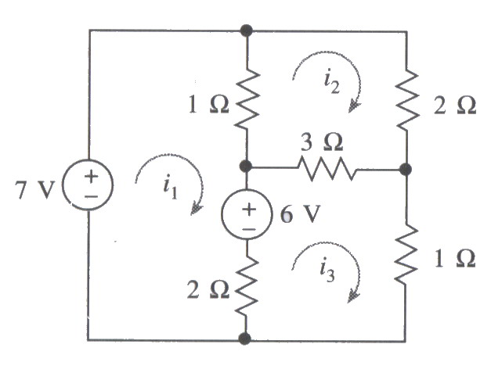
Latihan
Gunakan analisis mesh untuk menentukan ketiga arus dalam rangkaian berikut !

Slide 40
Mesh 1
Mesh 2

Slide 41
Mesh 3

Slide 42
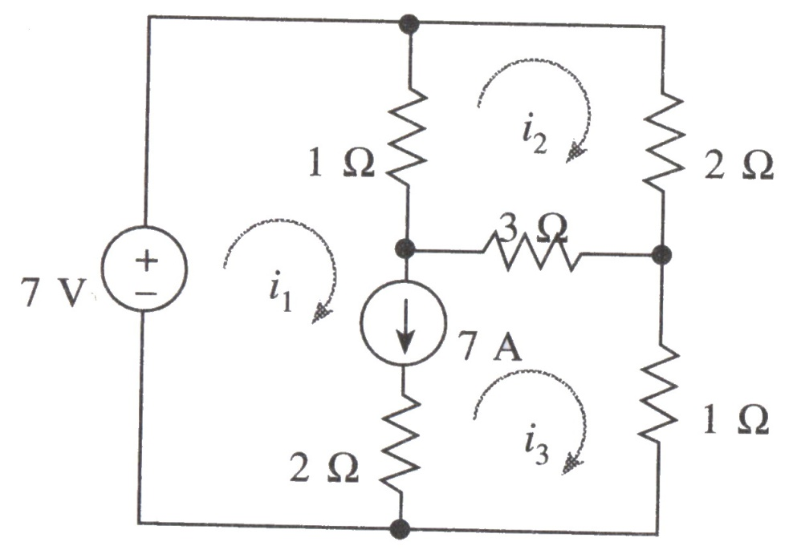
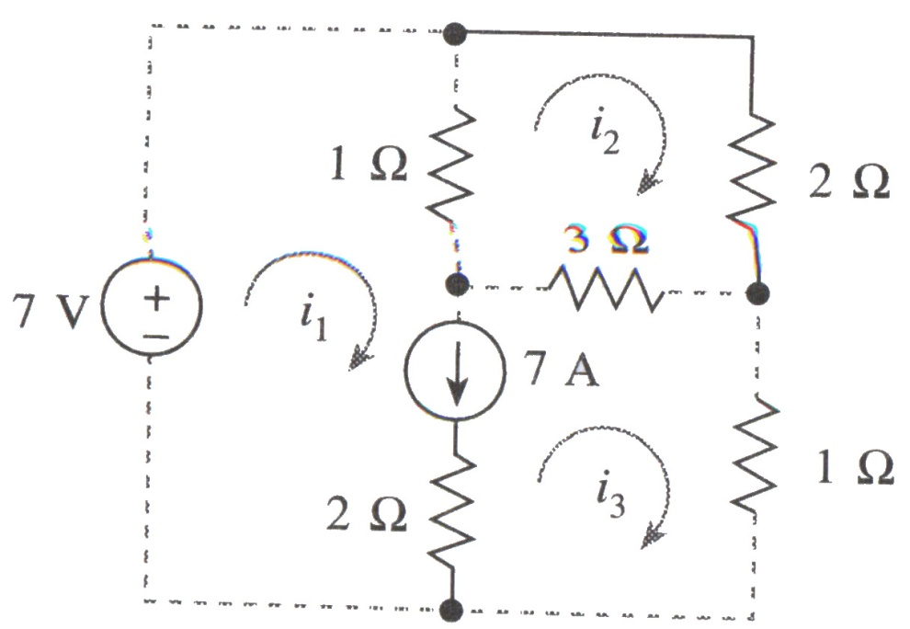
Mesh Super
Terdapat sumber arus di antara dua buah mesh

Slide 43
Mesh 1
Mesh 2

Slide 44
Sumber Arus Bebas

Slide 45
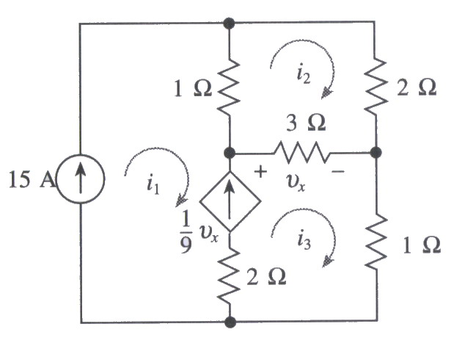
Tugas
Tentukan ketiga arus berikut !

Slide 46
4.20
4.22
4.30
4.35

